Slide 1
SQL

Slide 2
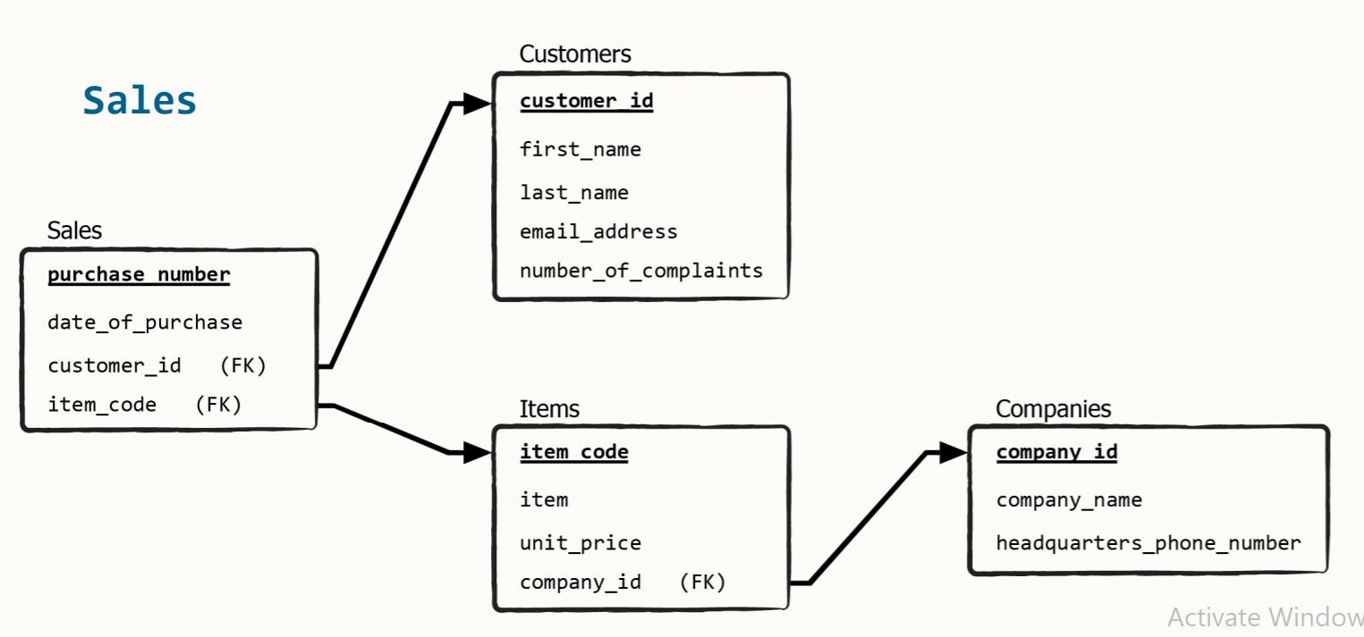
Look Here

Slide 3
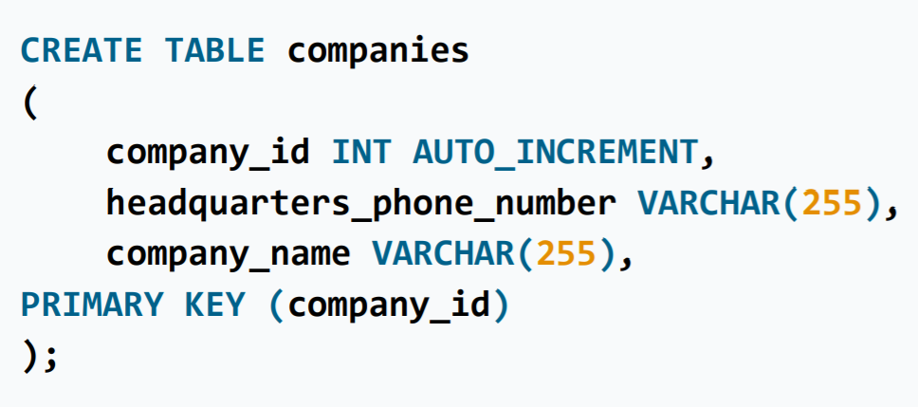
Creating a Table
CREATE DATABASE [IF NOT EXISTS] sales;
CREATE TABLE table_name ( column_1 data_type constraints, column_2 data_type constraints, … column_n data_type constraints);

Slide 4
Using Databases and Tables
USE sales;
SELECT * FROM customers;
OR
SELECT * FROM sales.customers;
Why this “.”

Slide 5
Download DATABASE
https://www.dropbox.com/s/znmjrtlae6vt4zi/employees.sql?dl=0 (Employees)
https://drive.google.com/open?id=1WDUzJg9EoxUi7FMrQL8jGJRQeunNZcCO (OnlineStore)

Slide 6
How to Load Database
If use are using Command Line Client
source C:\Users\A\Desktop\DS Interview-personal\Sqldata.sql;
If you are using workbench simply open the file and run it
Make sure your server is working
This is the location of your File

Slide 7
SELECT - FROM - exercise
Select the information from the “dept_no” column of the “departments” table.
Select all data from the “departments” table.

Slide 8
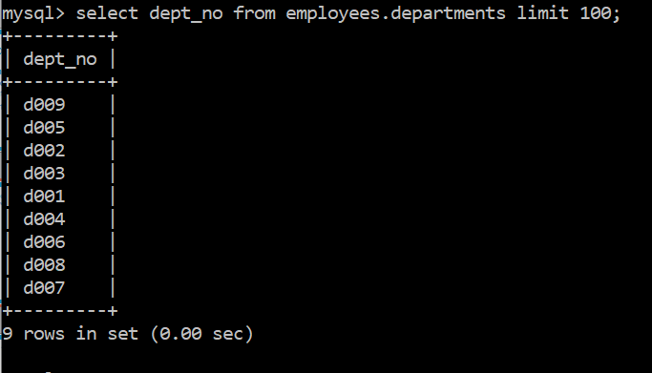
Select the information from the “dept_no” column of the “departments” table.

Slide 9
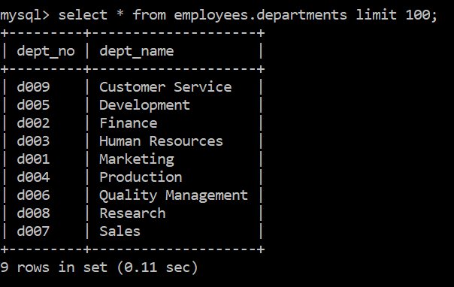
Select all data from the “departments” table.

Slide 10
WHERE - exercise
Select all people from the “employees” table whose first name is “Elvis”.

Slide 11
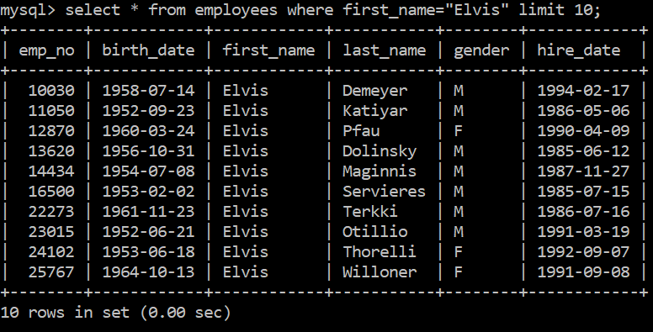
Select all people from the “employees” table whose first name is “Elvis”.

Slide 12
AND - exercise
Retrieve a list with all female employees whose first name is Kellie.

Slide 13
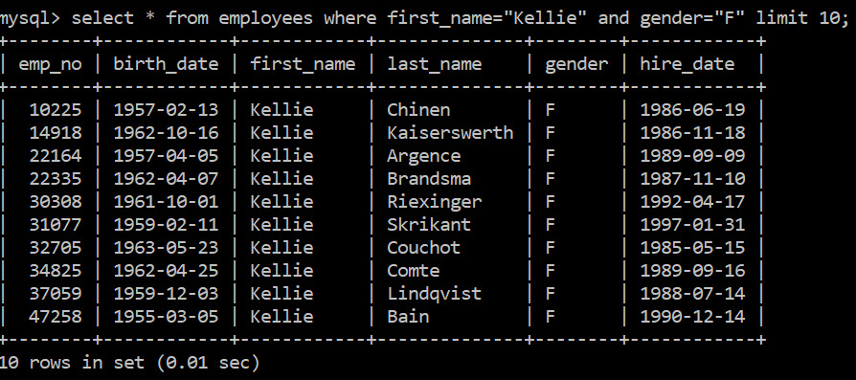
Retrieve a list with all female employees whose first name is Kellie.

Slide 14
OR - exercise
Retrieve a list with all employees whose first name is either Kellie or Aruna.

Slide 15
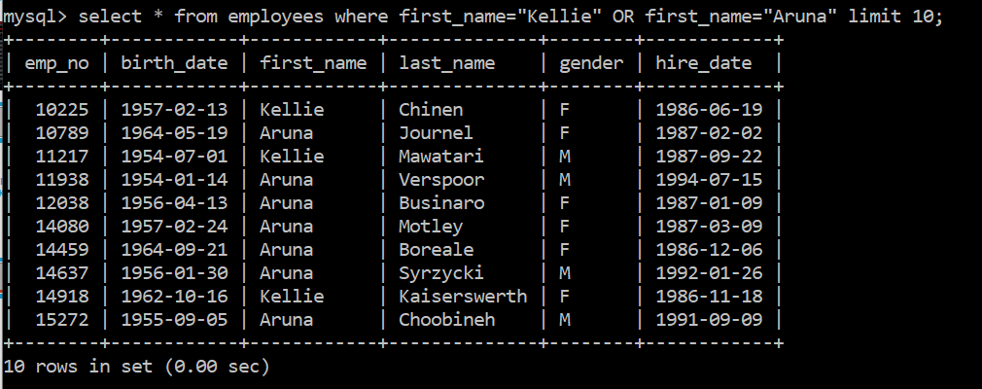
Retrieve a list with all employees whose first name is either Kellie or Aruna.

Slide 16
Operator Precedence
logical operator precedence an SQL rule stating that in the execution of the query, the operator AND is applied first, while the operator OR is applied second
AND > OR
Operator Precedence regardless of the order in which you use these operators, SQL will always start by reading the conditions around the AND operator

Slide 17
Operator Precedence-exercise
Retrieve a list with all female employees whose first name is either Kellie or Aruna.

Slide 18
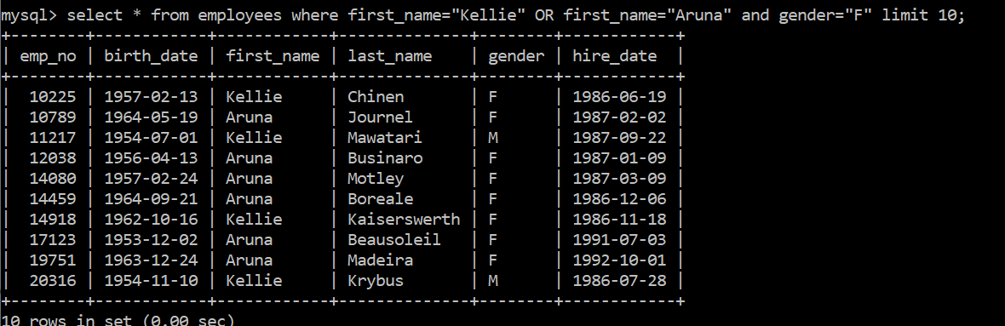

Slide 19
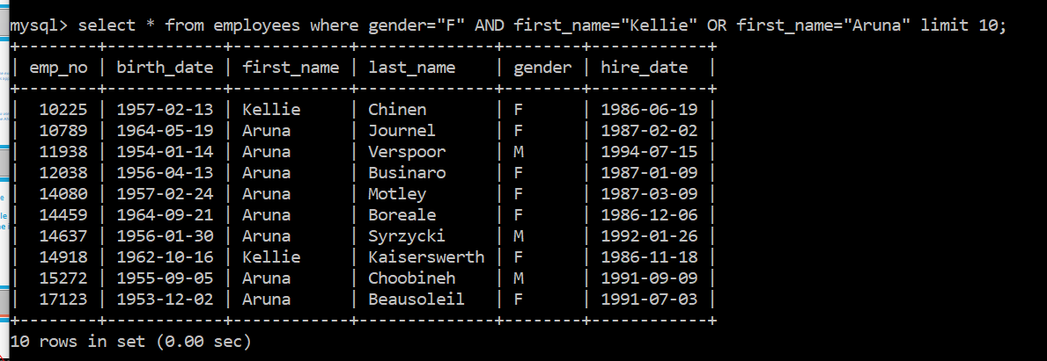

Slide 20
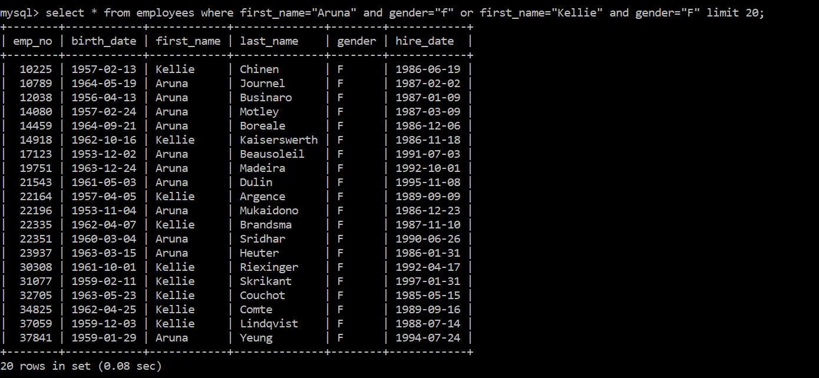
Retrieve a list with all female employees whose first name is either Kellie or Aruna.

Slide 21
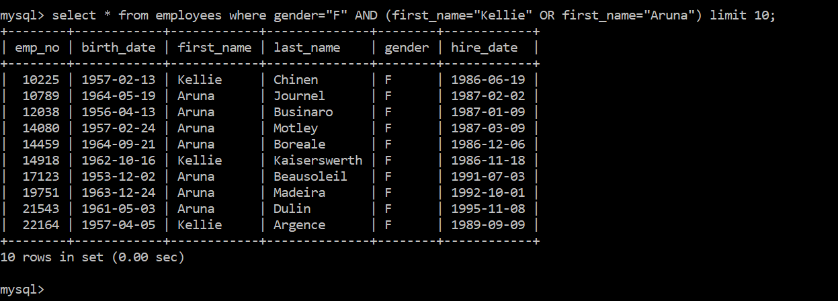
Retrieve a list with all female employees whose first name is either Kellie or Aruna.
The other way

Slide 22
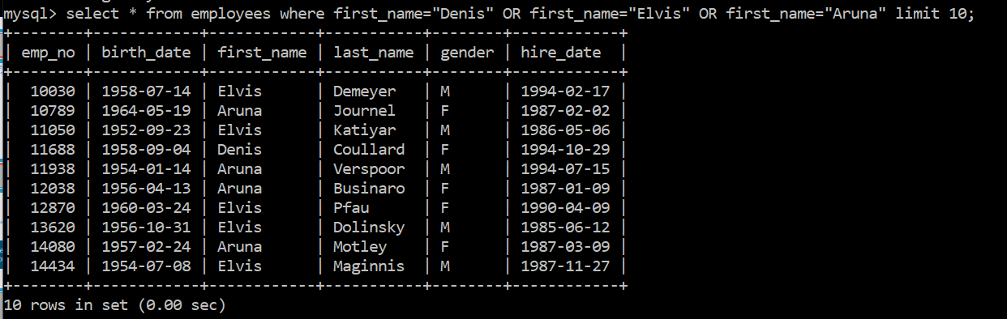
Select all individuals from the “employees” table, whose first name is either “Denis”, or “Elvis”, or ”Aruna” .

Slide 23

Is there any way by which we have not to use multiple “OR”

Slide 24

Yes, The “IN” OPERATOR

Slide 25
IN - NOT IN - exercise 1
Use the IN operator to select all individuals from the “employees” table, whose first name is either “Denis”, or “Elvis”, or ”Aruna”.

Slide 26
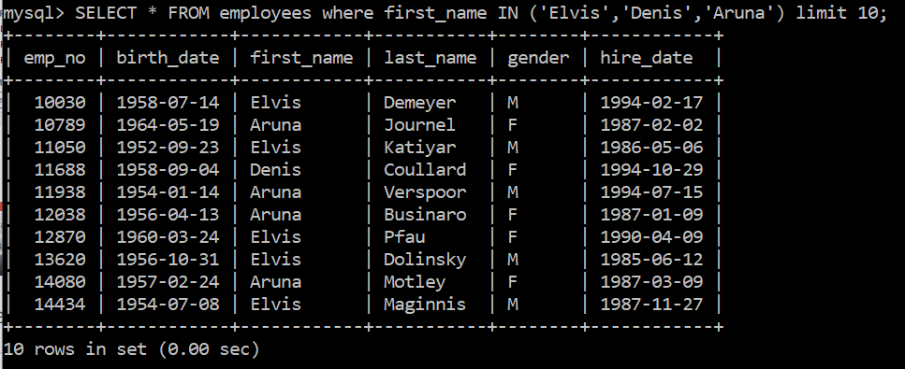
Use the IN operator to select all individuals from the “employees” table, whose first name is either “Denis”, or “Elvis”, or ”Aruna”.

Slide 27
IN - NOT IN - exercise 2
Extract all records from the ‘employees’ table, aside from those with employees named Elvis,Denis or Aruna.
Can we use “OR” here???

Slide 28
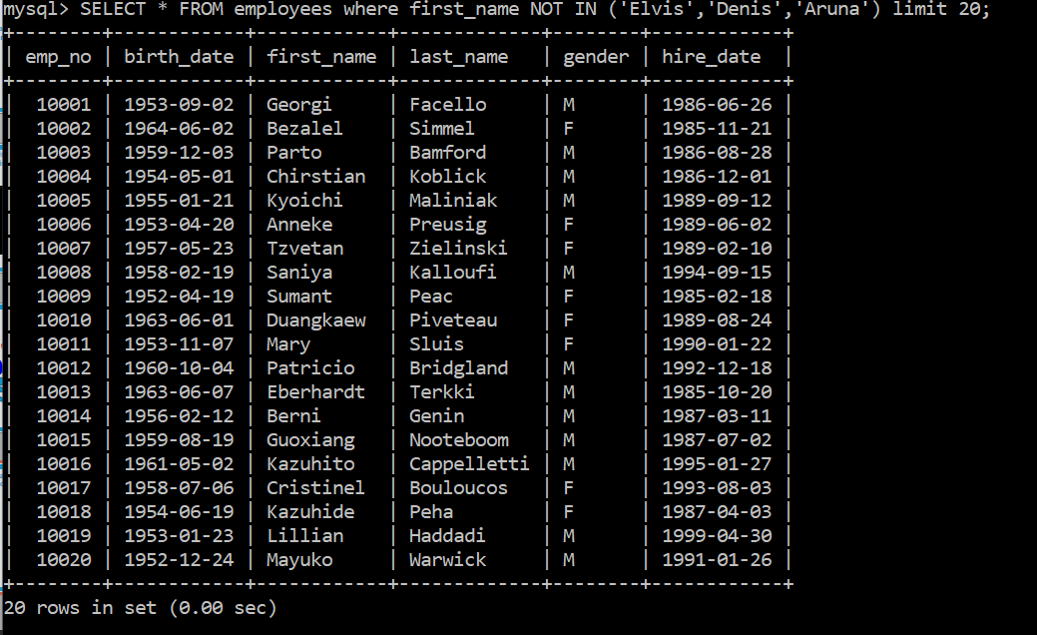
Extract all records from the ‘employees’ table, aside from those with employees named Elvis,Denis or Aruna.

Slide 29
LIKE - NOT LIKE - exercise
Working with the “employees” table, use the LIKE operator to select the data about all individuals, whose first name starts with “Mark”; specify that the name can be succeeded by any sequence of characters.

Slide 30

Wildcard Characters
you would need a wildcard character whenever you wished to put “anything” on its place

Slide 31

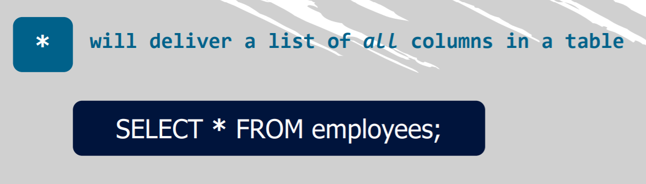

Slide 32

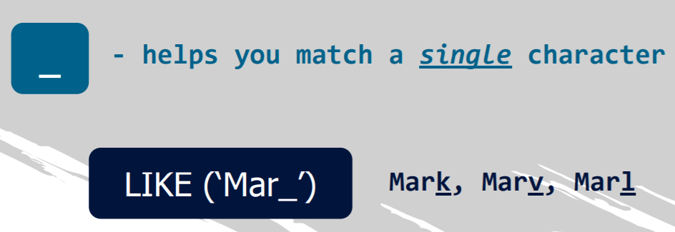

Slide 33

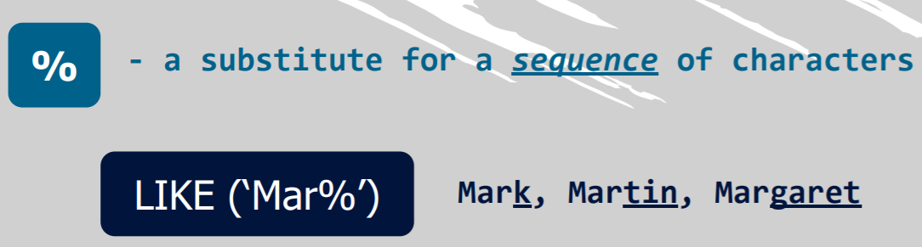

Slide 34
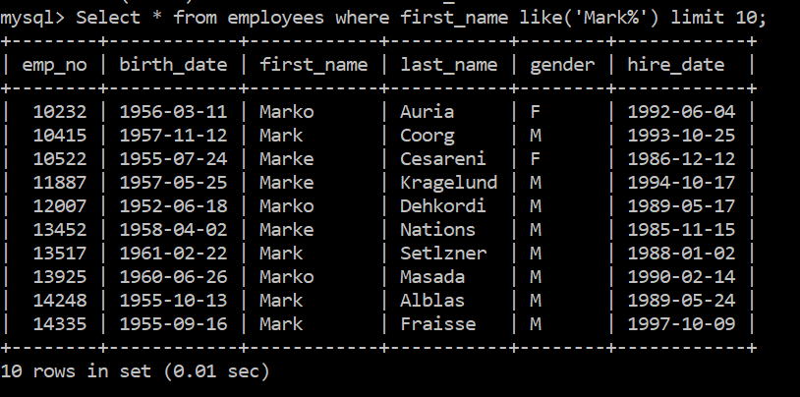
Working with the “employees” table, use the LIKE operator to select the data about all individuals, whose first name starts with “Mark”; specify that the name can be succeeded by any sequence of characters.

Slide 35
LIKE - NOT LIKE - exercise
Retrieve a list with all employees who have been hired in the year 2000.

Slide 36
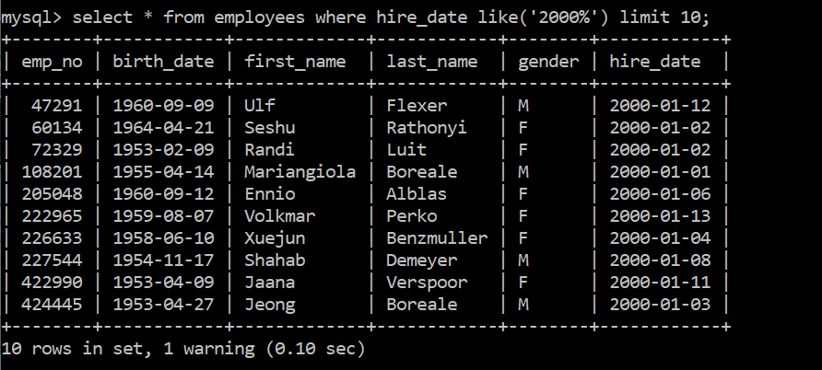
Retrieve a list with all employees who have been hired in the year 2000.

Slide 37
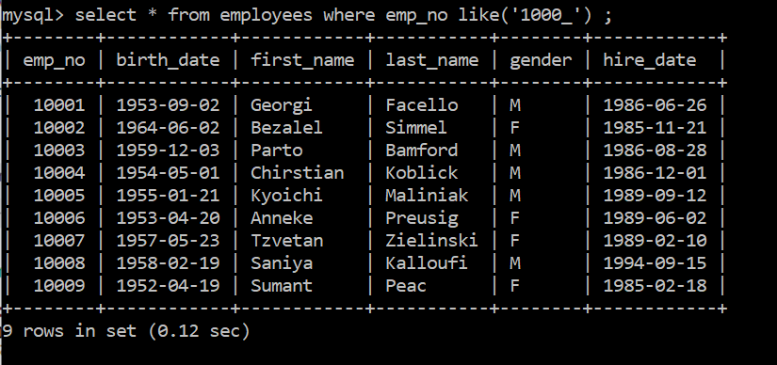
Retrieve a list with all employees whose employee number is written with 5 characters, and starts with “1000”.

Slide 38
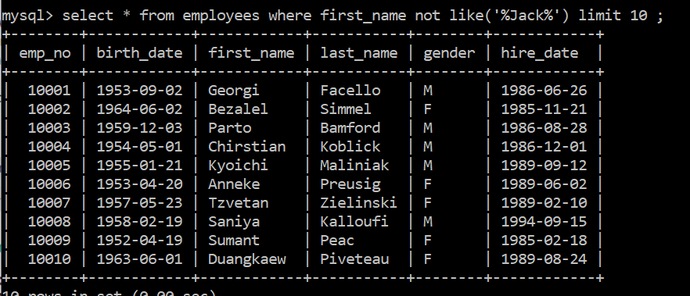
Extract list containing the names of employees that do not contain “Jack”.

Slide 39
BETWEEN - AND - exercise
Select all the information from the “salaries” table regarding contracts from 66,000 to 70,000 dollars per year.

Slide 40
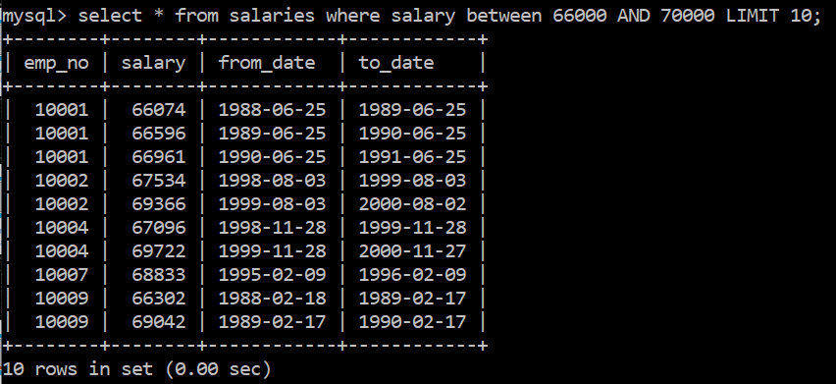
Select all the information from the “salaries” table regarding contracts from 66,000 to 70,000 dollars per year.

Slide 41
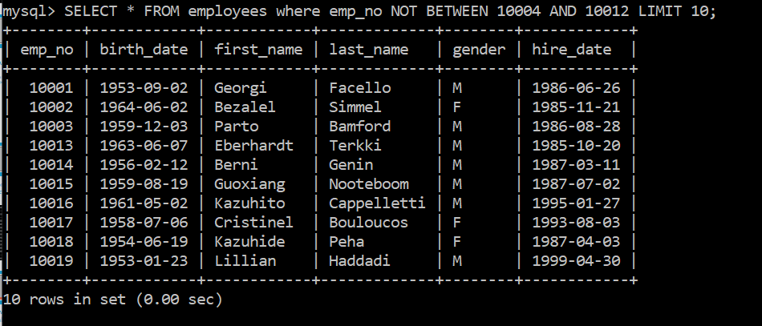
Retrieve a list with all individuals whose employee number is not between ‘10004’ and ‘10012’.

Slide 42
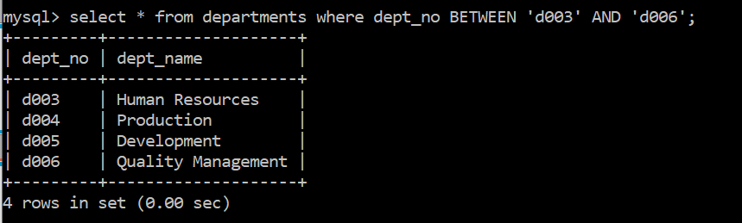
Select the names of all departments with numbers between ‘d003’ and ‘d006’.

Slide 43
IS NOT NULL - IS NULL - exercise
Select the names of all departments whose department number value is not null.

Slide 44
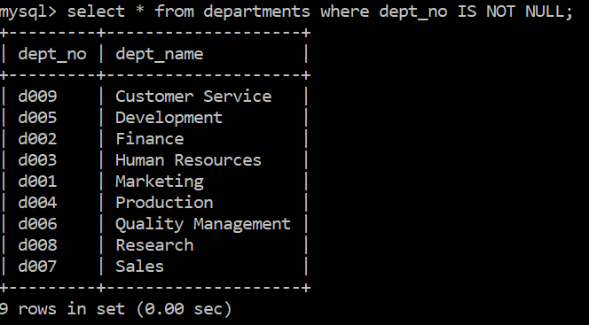
Select the names of all departments whose department number value is not null.

Slide 45
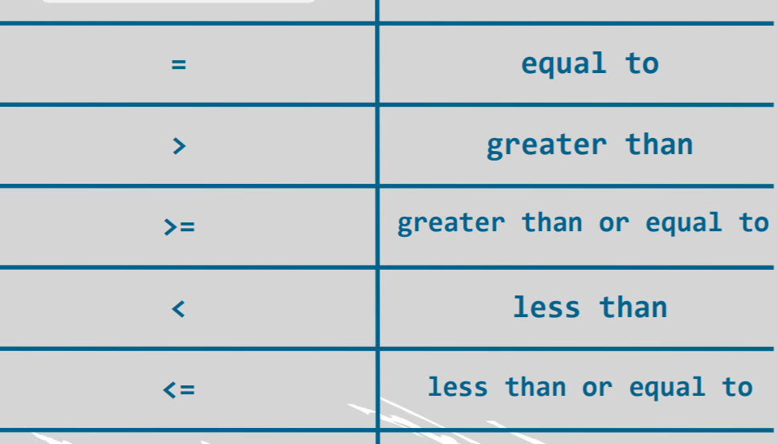
Other comparison operators

Slide 46
Other comparison operators - exercise

Slide 47
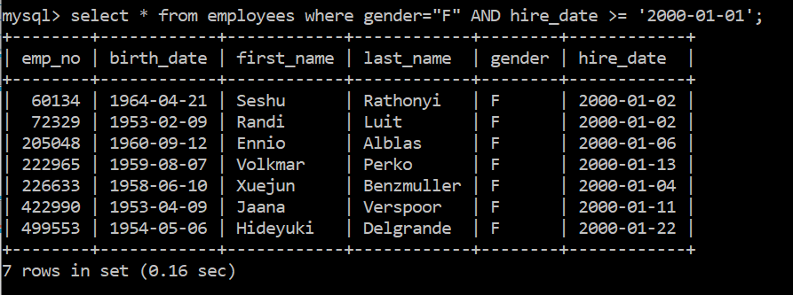
Retrieve a list with data about all female employees who were hired in the year 2000 or after. Hint: If you solve the task correctly, SQL should return 7 rows.

Slide 48
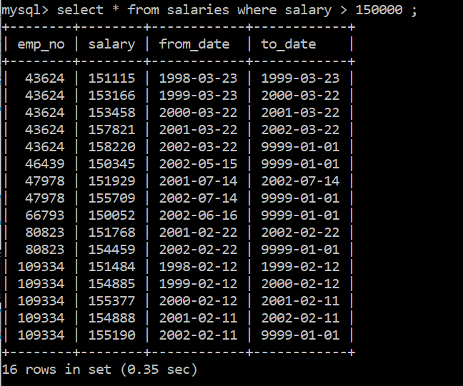
Extract a list with all employees’ salaries higher than $150,000 per annum.

Slide 49
SELECT DISTINCT - exercise

Slide 50
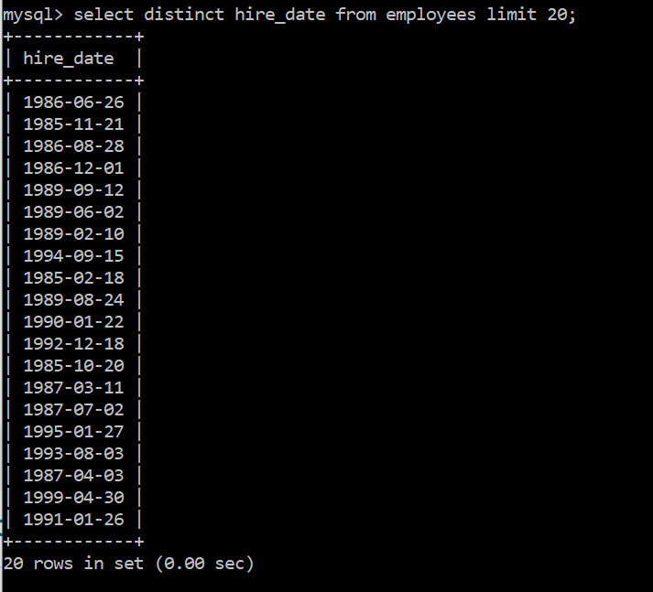
Obtain a list with all different “hire dates” from the “employees” table.

Slide 51
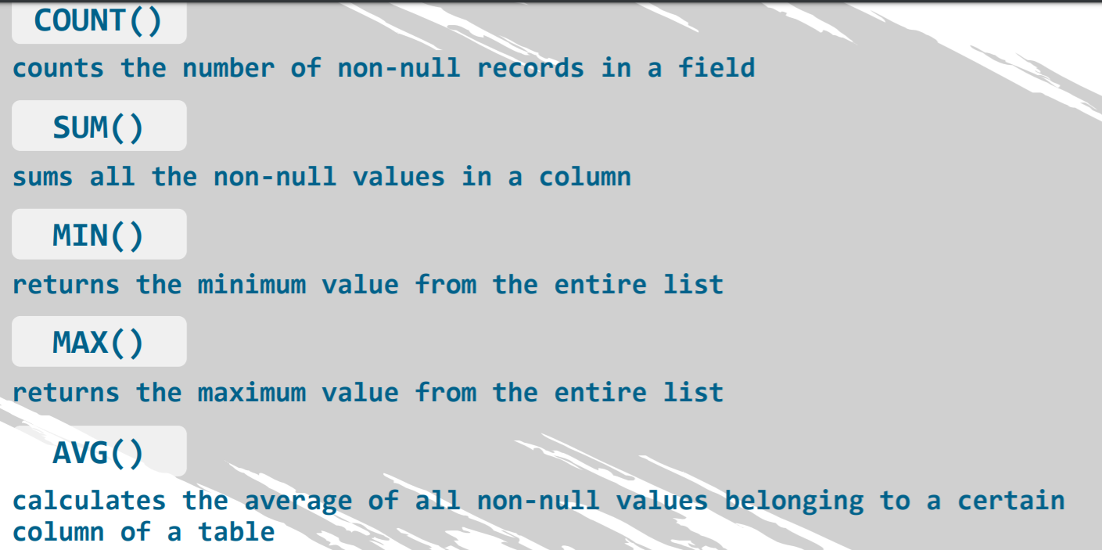
Aggregate Functions
they are applied on multiple rows of a single column of a table and return an output of a single value

Slide 52
Aggregate functions - exercise

Slide 53
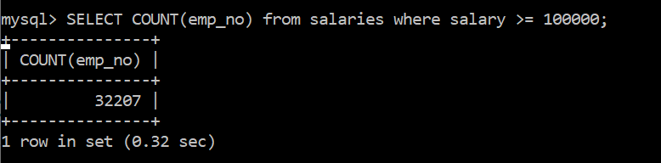
How many annual contracts with a value higher than or equal to $100,000 have been registered in the salaries table?

Slide 54
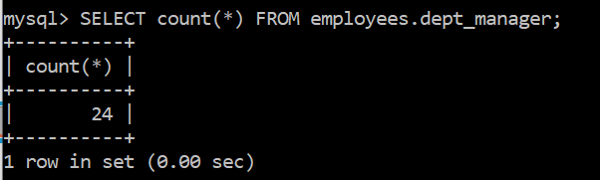
How many managers do we have in the “employees” database? Use the star symbol (*) in your code to solve this exercise.

Slide 55
ORDER BY - exercise

Slide 56
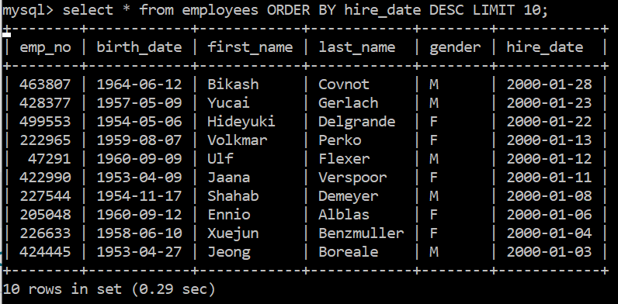
Select all data from the “employees” table, ordering it by “hire date” in descending order.

Slide 57
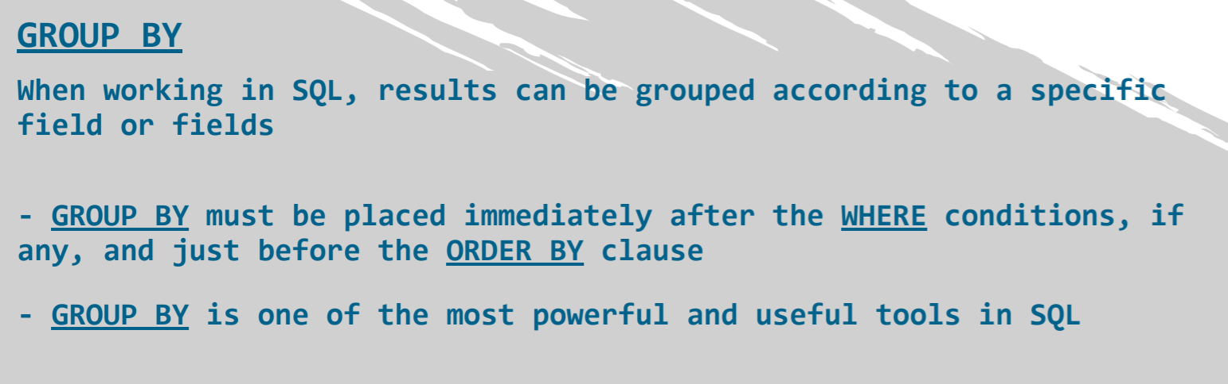
GROUP BY

Slide 58
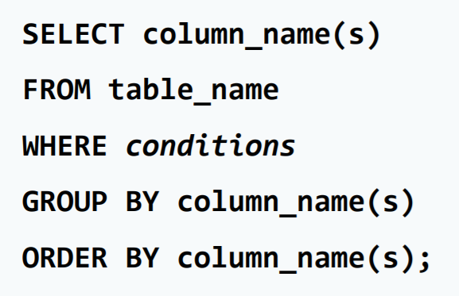
GROUP BY

Slide 59
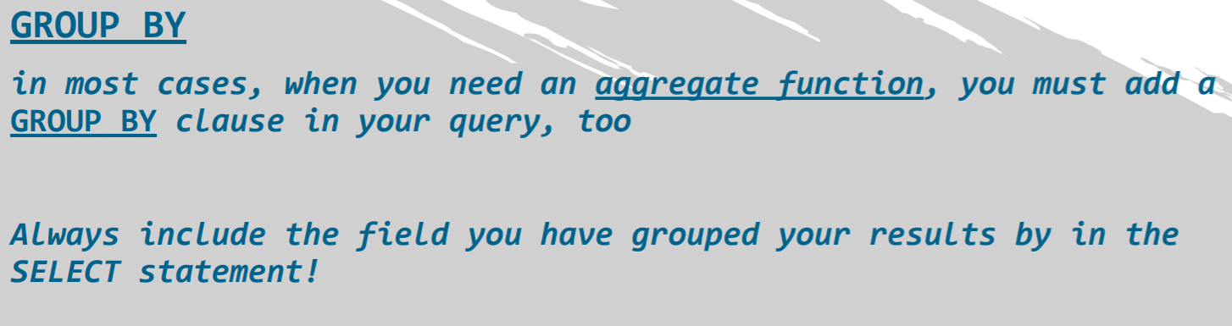
GROUP BY

Slide 60
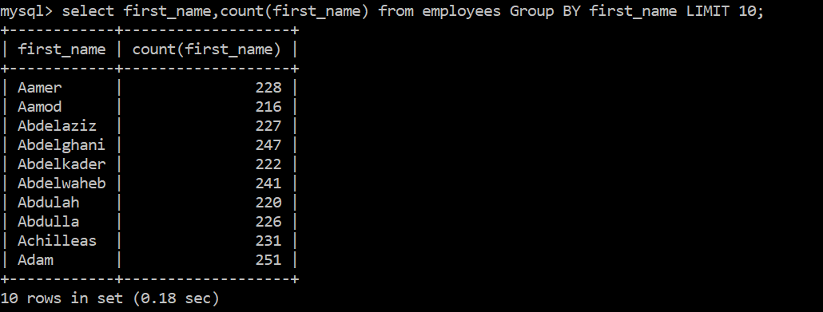
GROUP BY - exercise
Get the list of Frist name and the number of times they have appeared in the table.

Slide 61
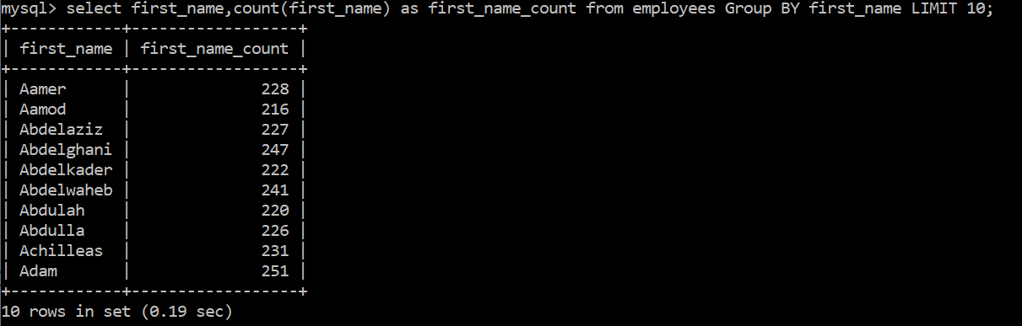
ALIASES- exercise
Get the list of Frist name and the number of times they have appeared in the table and make the count filed as first_name_count.

Slide 62
Get the list of Frist name which has appeared more than 200 times but less than 220 times.

Slide 63


Slide 64
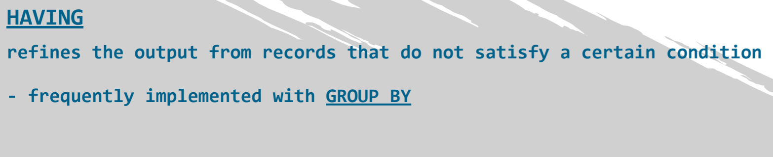
HAVING

Slide 65
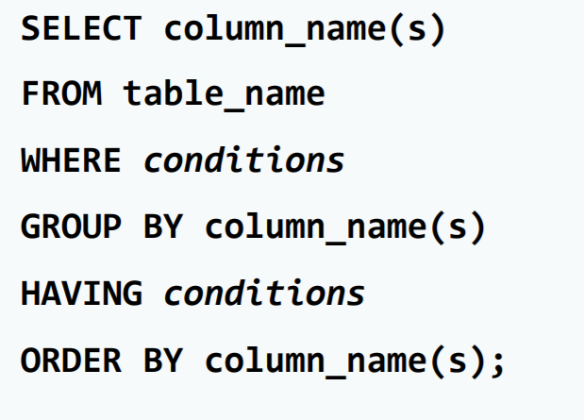
HAVING

Slide 66
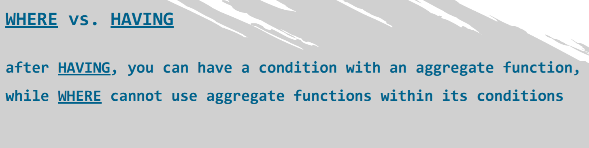
HAVING

Slide 67
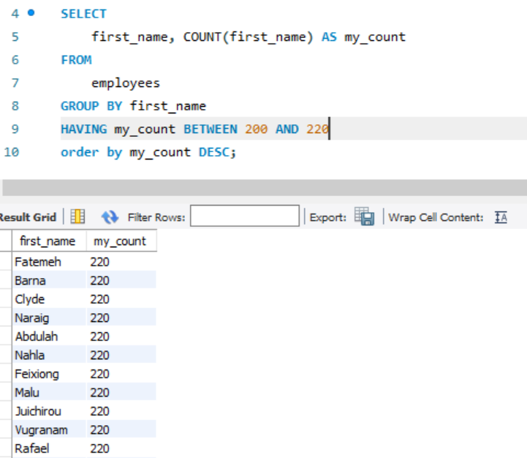
HAVING- exercise
Get the list of Frist name which has appeared more than 200 times but less than 220 times.

Slide 68
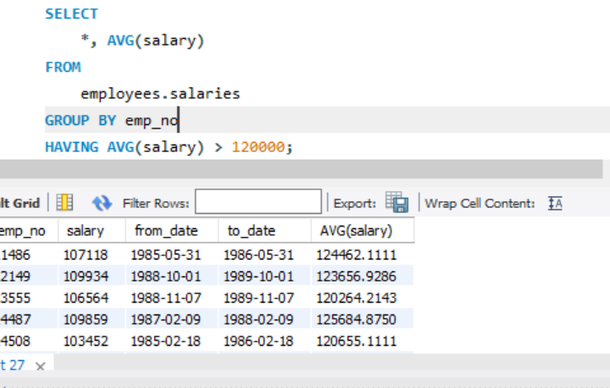
Select all employees whose average salary is higher than $120,000 per annum. Hint: You should obtain 101 records.

Slide 69
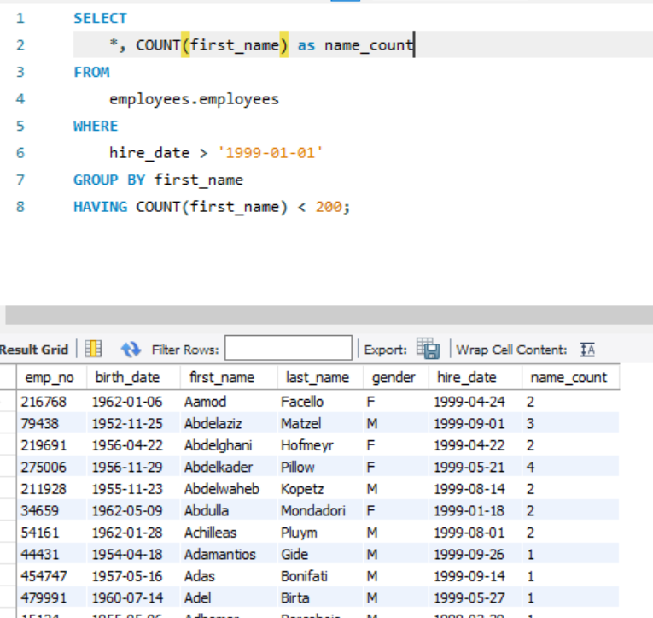
Extract a list of all first names that are encountered less than 200 times. Let the data refer to people hired after 1st –Jan-1999.

Slide 70
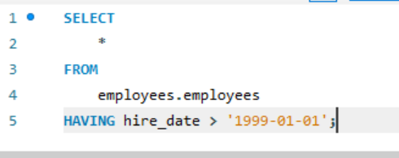
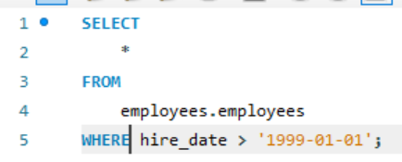
VS

Slide 71
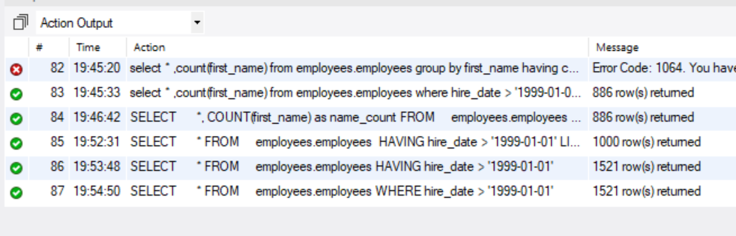
What was the difference?
Same Result, Cool!!!!!

Slide 72
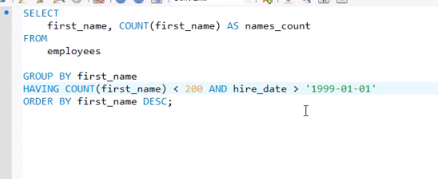
Lets Do Another Example

Slide 74
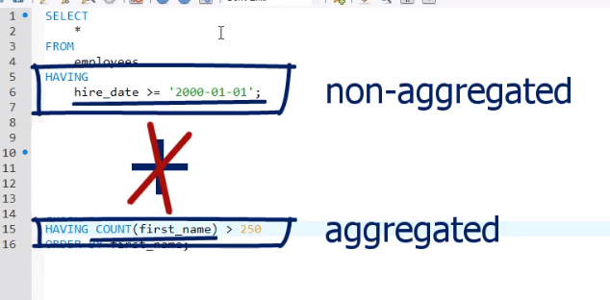

Slide 75

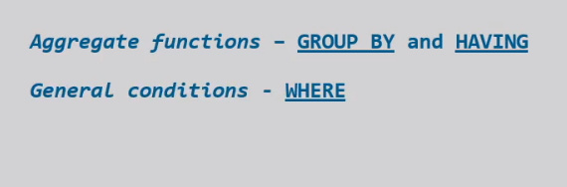
Rule of Thumb

Slide 76
WHERE vs HAVING - Part II - exercise Select the employee numbers of all individuals who have signed more than 1 contract after the 1st of January 2000. Hint: To solve this exercise, use the “dept_emp” table.

Slide 77


Slide 78
SUM function
What is the total amount of money spent on salaries for all contracts starting after the 1st of January 1997?

Slide 79


Slide 80

AVG() - exercise
What is the average annual salary paid to employees who started after the 1st of January 1997?

Slide 81

Round the average amount of money spent on salaries for all contracts that started after the 1st of January 1997 to a precision of paise.

Slide 82

COALESCE()

Slide 83
Window Functions
Name | Description
Cume_dist() | Cumulative distribution value
Dense_rank() | Rank of current row within its partition, without gaps
First_value() | Value of argument from first row of window frame
Lag() | Value of argument from row lagging current row within partition
Last_value() | Value of argument from last row of window frame
Lead() | Value of argument from row leading current row within partition
Nth_value() | Value of argument from N-th row of window frame
Ntile() | Bucket number of current row within its partition.
Percent_rank() | Percentage rank value
Rank() | Rank of current row within its partition, with gaps
Row_number() | Number of current row within its partition

Slide 84
Window Functions
https://codingsight.com/methods-to-rank-rows-in-sql-server-rownumber-rank-denserank-and-ntile/
Please refer to above link
https://dev.mysql.com/doc/refman/8.0/en/window-function-descriptions.html
Link from my SQL

Slide 85

Rank Exerecise
Rank all the salaries;

Slide 86

Rank Exercise-Solution

Slide 87
Rank Exercise-Solution(The other way)
SELECT
*,
RANK() OVER (
ORDER BY salary desc
) myrank
FROM
salaries limit 10;

Slide 88

Rank Exercise-Solution(The other way)

